Slide 1

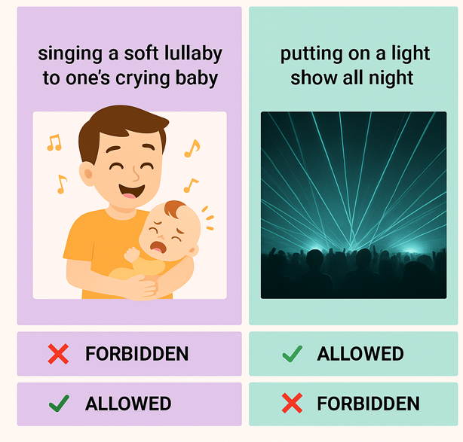
Are these behaviors against the rule?
Singing a lullaby to one’s crying baby | Putting on a late-night light show
NO MUSIC
PAST 10PM
Textualist verdict: | FORBIDDEN |  | ALLOWED
Purposivist verdict: | ALLOWED |  | FORBIDDEN

Slide 3
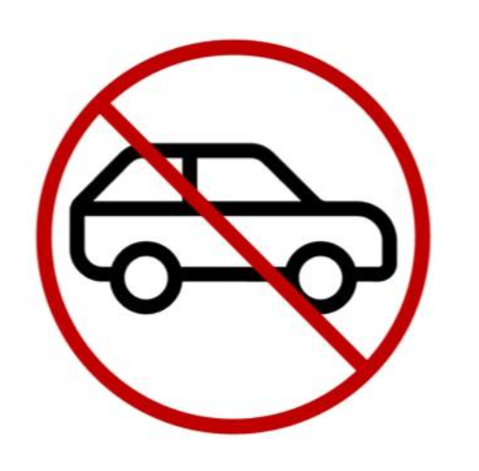

2. Control cases
Remember…
The rule says: “No cars allowed on the path.”
Purpose: To protect the people who walk on the path.
One day, John drives on the path at 100 kilometers per hour.
Did John obey the new rule?’
Remember…
The rule says: “No cars allowed on the path.”
Purpose: To protect the people who walk on the path.
One day, Anne goes for a walk on the path.
Did Anne obey the new rule?’
1. Rule presentation
To protect people who walk along the path, the park boss came up with a new rule.’
The rule says: “No cars allowed on the path.”’
YES
NO
YES
NO
3. Conflict cases
Remember…
The rule says: “No cars allowed on the path.”
Purpose: To protect the people who walk on the path.
One day, Sarah rides a motorcycle on the path at 100 kilometers per hour.
Did Sarah obey the new rule?’
Remember…
The rule says: “No cars allowed on the path.”
Purpose: To protect the people who walk on the path.
One day, Jane drives an ambulance on the path to rescue a girl who has fallen.
Did Juan obey the new rule?’
YES
NO
YES
NO

Slide 4
2. Control cases
3. Conflict cases
1. Rule presentation
Remember…
The rule says: “No cars allowed on the path.”
Purpose: To protect the people who walk on the path.
One day, John drives on the path at 100 kilometers per hour.
Did John obey the new rule?’
Remember…
The rule says: “No cars allowed on the path.”
Purpose: To protect the people who walk on the path.
One day, Sarah rides a motorcycle on the path at 100 kilometers per hour.
Did Sarah obey the new rule?’
To protect people walking on the path,
the park boss came up with a new rule.’
The rule says:
“No cars allowed on the path.”’
Remember…
The rule says: “No cars allowed on the path.”
Purpose: To protect the people who walk on the path.
One day, Anne goes for a walk on the path.
Did Anne obey the new rule?’
Remember…
The rule says: “No cars allowed on the path.”
Purpose: To protect the people who walk on the path.
One day, Jane drives an ambulance on the path to rescue a girl who has fallen.
Did Juan obey the new rule?’
YES
NO
YES
NO
YES
NO
YES
NO

Slide 5
1. Rule presentation | 2. Control cases | 3. Conflict cases
A

